Slide 1


How to create slides
Presentation and visualization

Slide 2

What should we pay attention to?
Message
Visual design
Delivery

Slide 3
Message

Slide 4
Message: Goal
Informative
Entertaining
Inspiring
Persuasive

Slide 5
MAKE IT SIMPLE PLEASE
Few words and lots of ideas
Less is more
Space is important

Slide 6
SUPRESS THE OBVIOUS, HIGHLIGHT THE SIGNIFICANT

Slide 7
Message: The structure
Main idea
Idea
Detail
Detail
Idea
Detail
Your main message
Important parts
Examples and anecdotes
Detail

Slide 8

Message, storytelling
Beginning
What-Who-When
Get your audience attention
Middle
How-Why
Keep the attention
End
Solution and benefits
Surprise
Soft start
Resolution
Keep the attention
Result or alternatives
Gift
Wrap-up
Wow
Structure
Audience
Tips

Slide 9
Visual design
Colour, layout, typography and images

Slide 10
Images and videos as background
Full screen image
Partial bleed image
Background with transparency
Video background with subtle movement

Slide 11
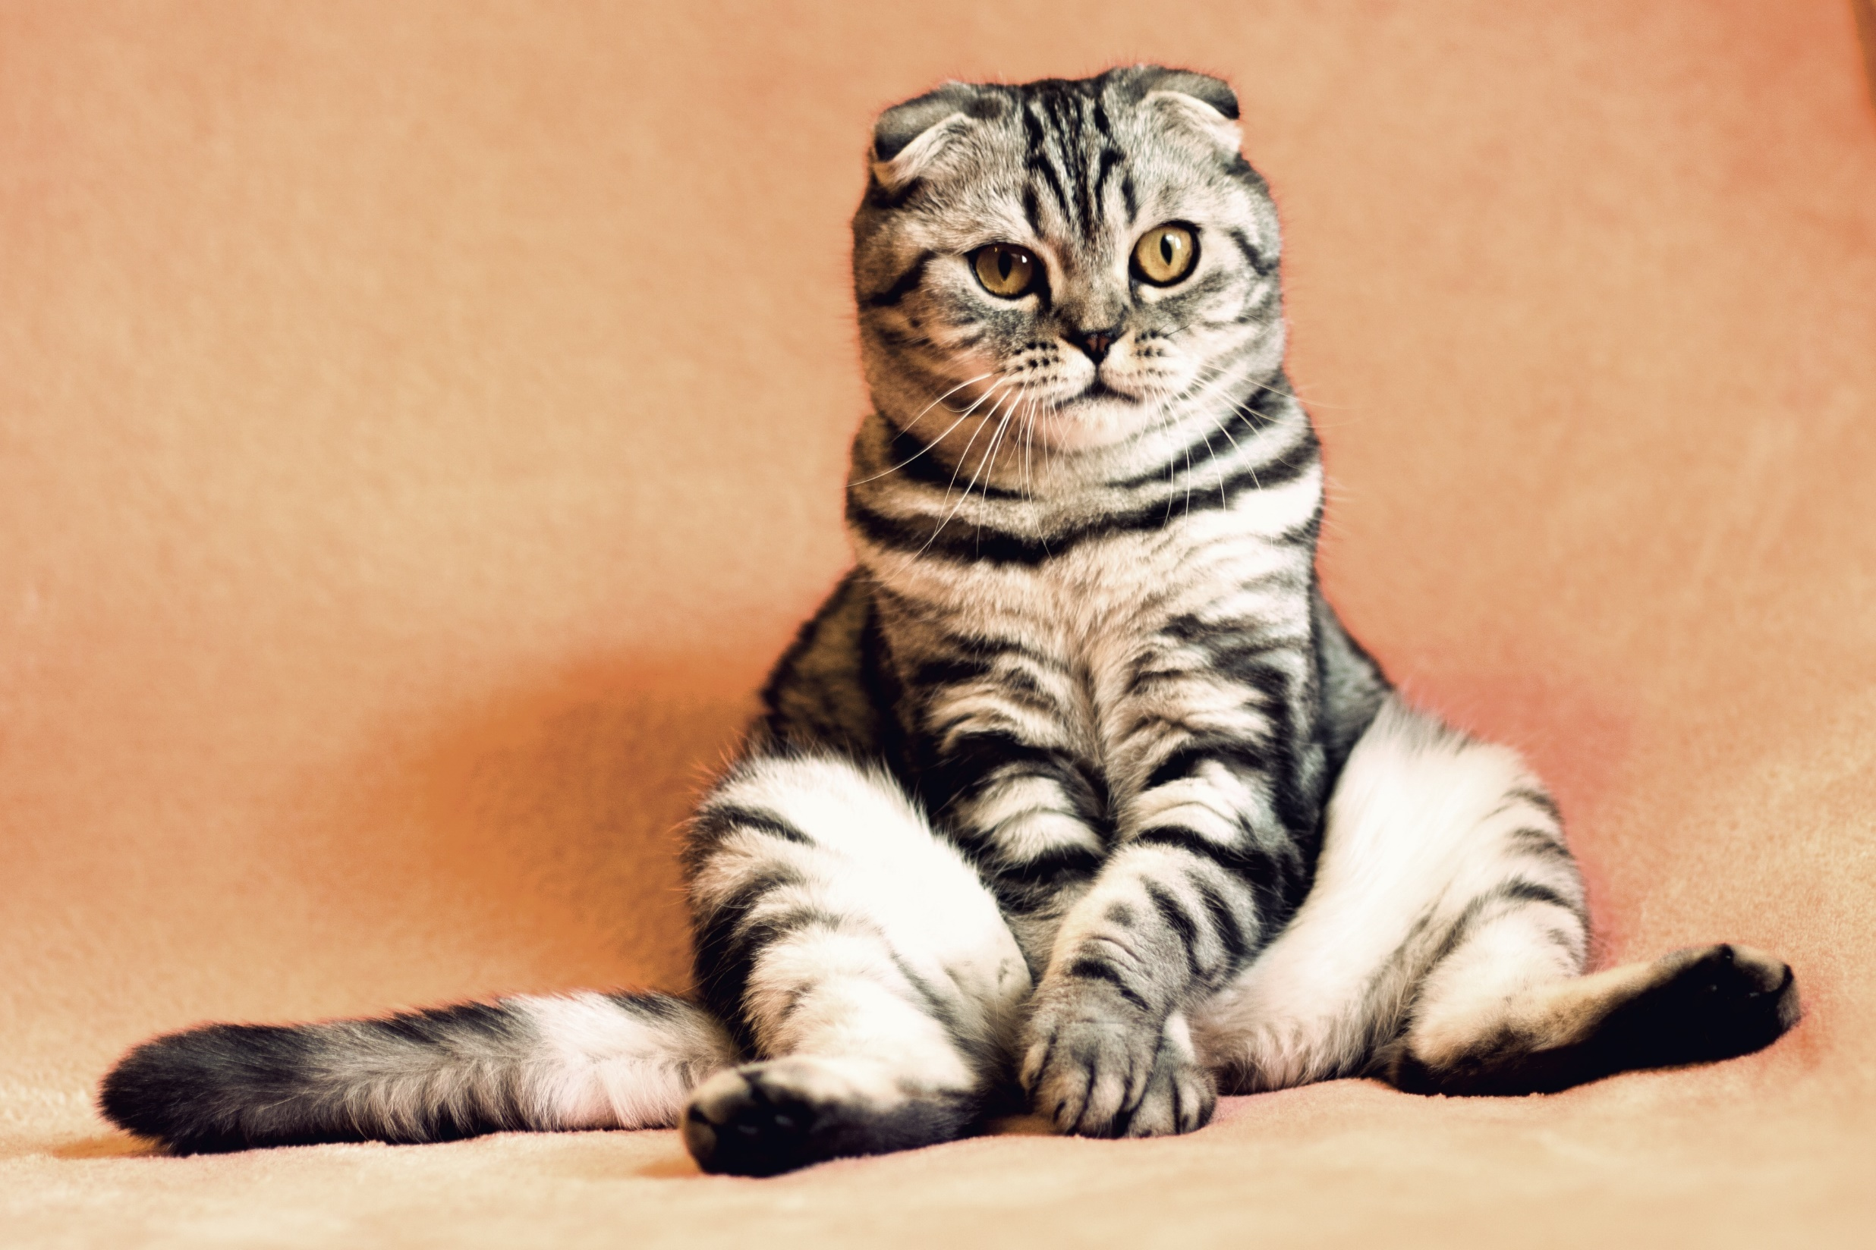
Full screen image

Slide 12
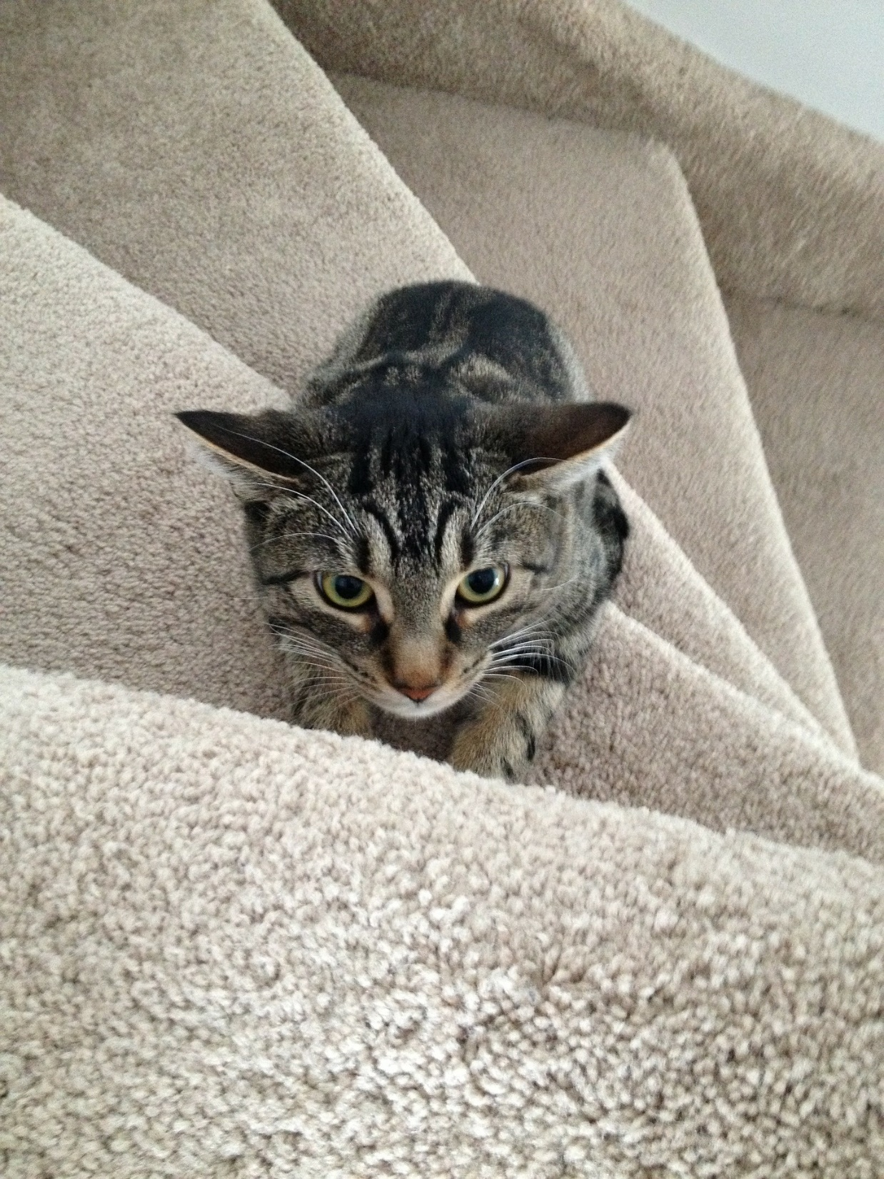
Partial bleed image

Slide 13

Transparent background image

Slide 14
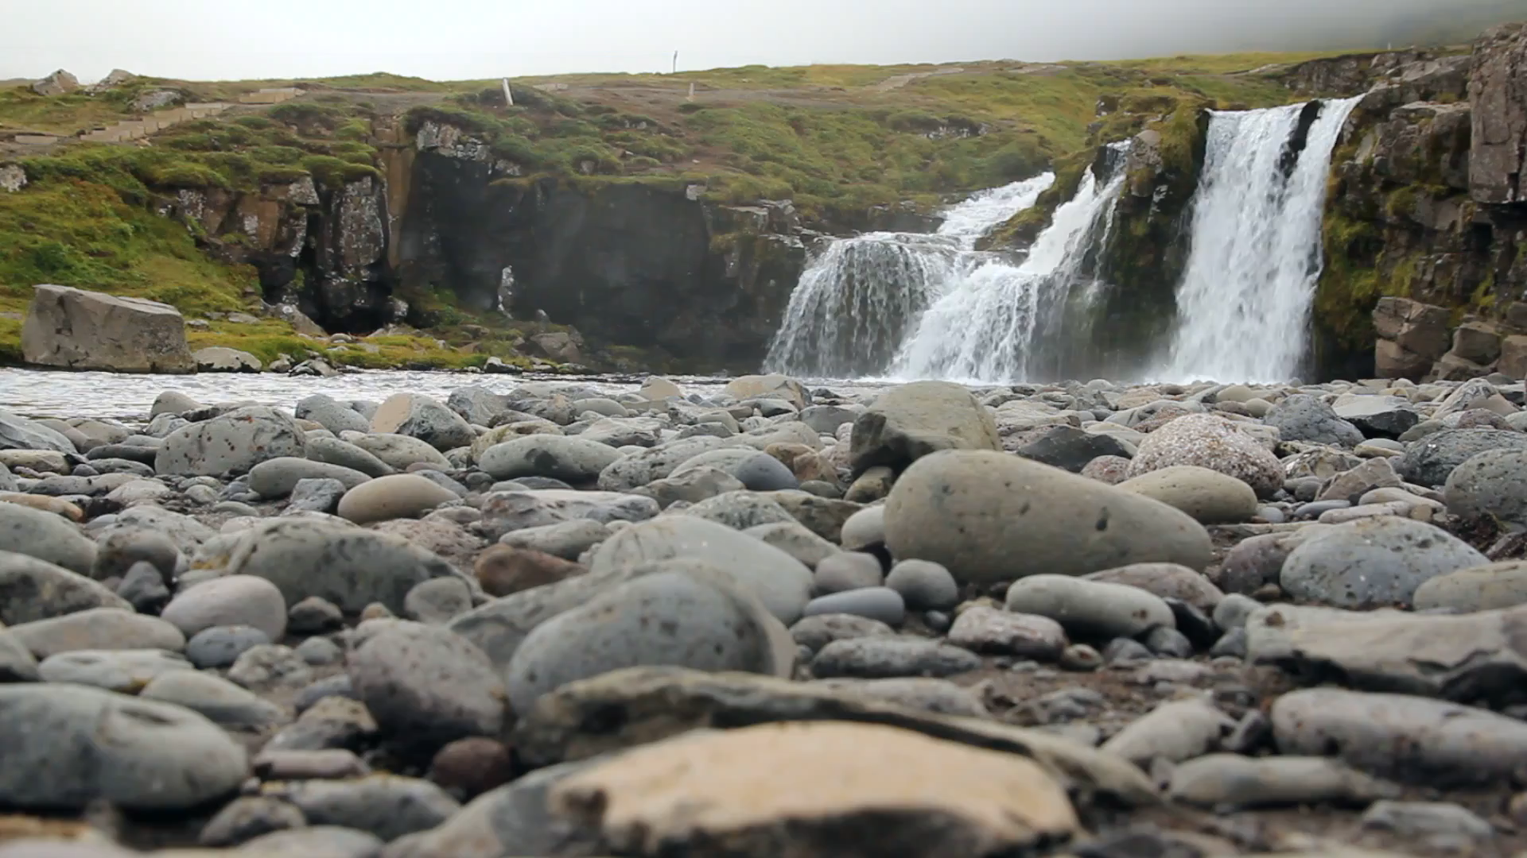
Background video with subtle movement

Slide 15
Background video, recommendations
Always
full screen
30 to 60 seconds
Authentic videos

Slide 16
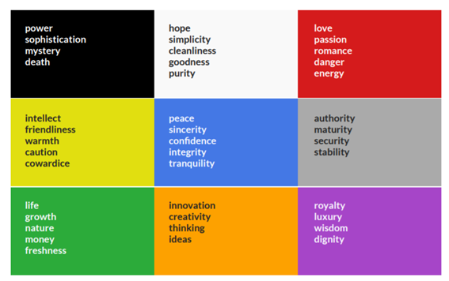
COLOUR
Notes:
Colour and emotion in films
Find images by colour

Slide 17




Colour combinations
Notes:
Warm colors for energy
Cool colors for calm and relax

Slide 18
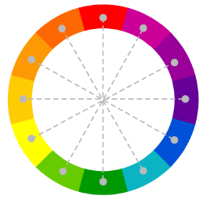
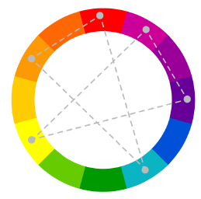
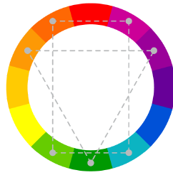
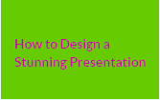
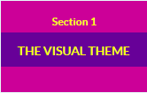
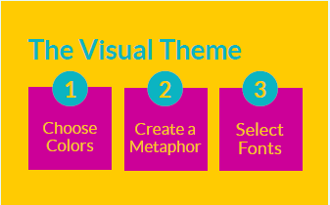
60-30-10
COMPLEMENTARY
Split COMPLEMENTARY
Triads AND TETRADIC

Slide 19
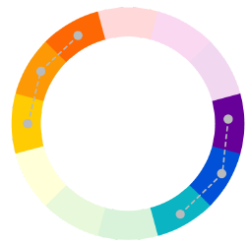
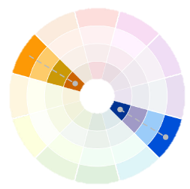
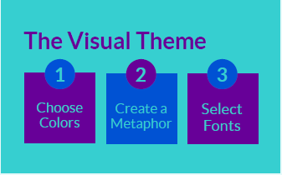
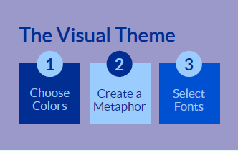
Color combinations, similar
Analogous colours
monochromatic

Slide 20
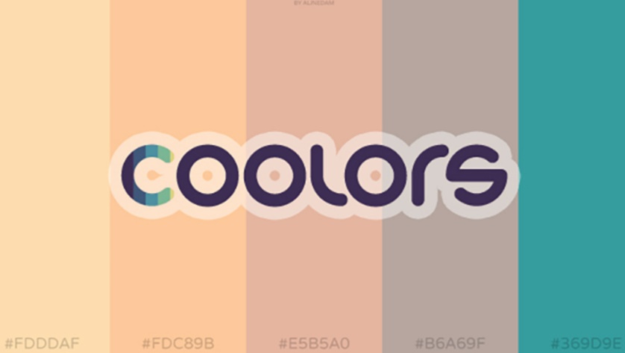
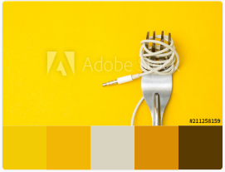
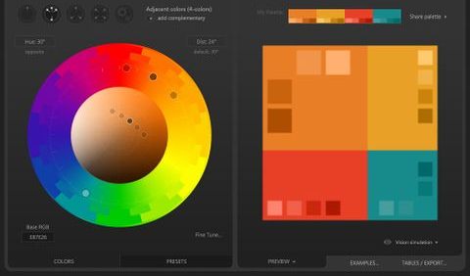
Colour scheme tools
https://coolors.co
https://color.adobe.com
http://paletton.com

Slide 21
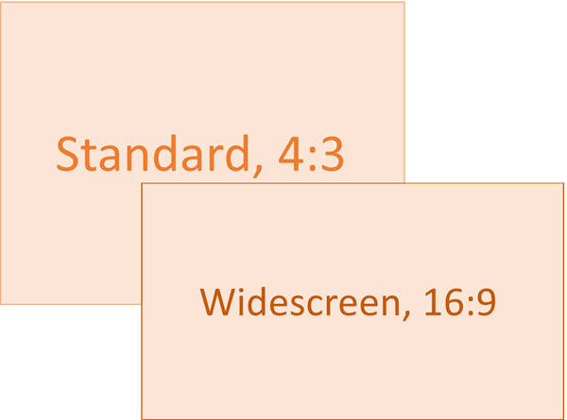
Layout: page setup

Slide 22
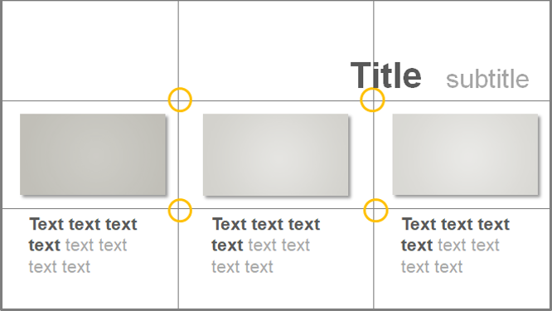
Layout: Composition

Slide 23
Layout
Balance vs
Dynamism
Visual hierarchy
Coherent design
Animations
Notes:
Balance vs Dynamism: Simmetry
Visual hierarchy: Size, Highlight, Depth , Contrast, Alignment
Coherent design: Associations, Visual connections, Repeated elements, Related = Close
Animations: start with the final, work backwards

Slide 24
Layout: some tips
Combine text and image
Harmonious design, consistent feel, implied movement
Layered effect
Overlays and shapes
Notes:
Lots of empty space, Blurred sections, Elements that direct the viewer's gaze
Balanced layouts, Marry images with text

Slide 25
Images within slides
1 Image per slide
Well framed collage

Slide 26



Images: some tips
Always high resolution (landscape slides 1366 x 768 px)
Crop to keep focus
Never distort

Slide 27


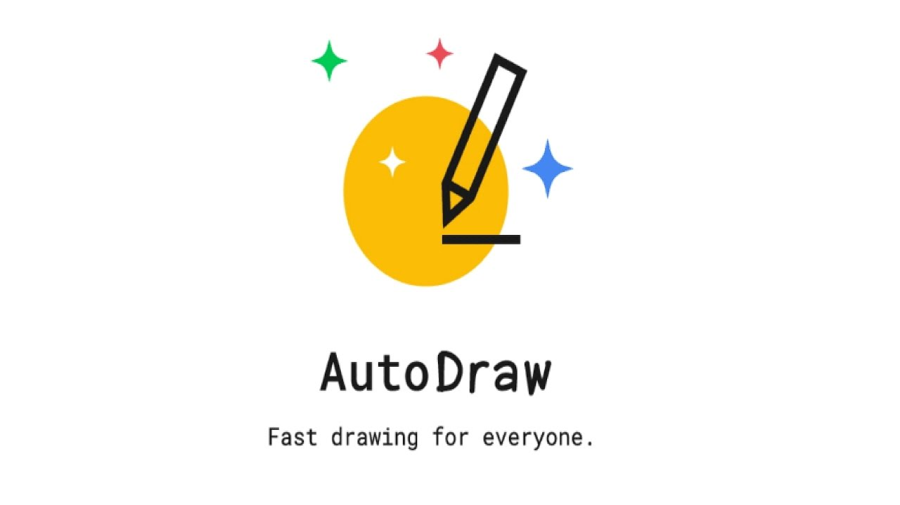



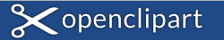
Image sources

Slide 28
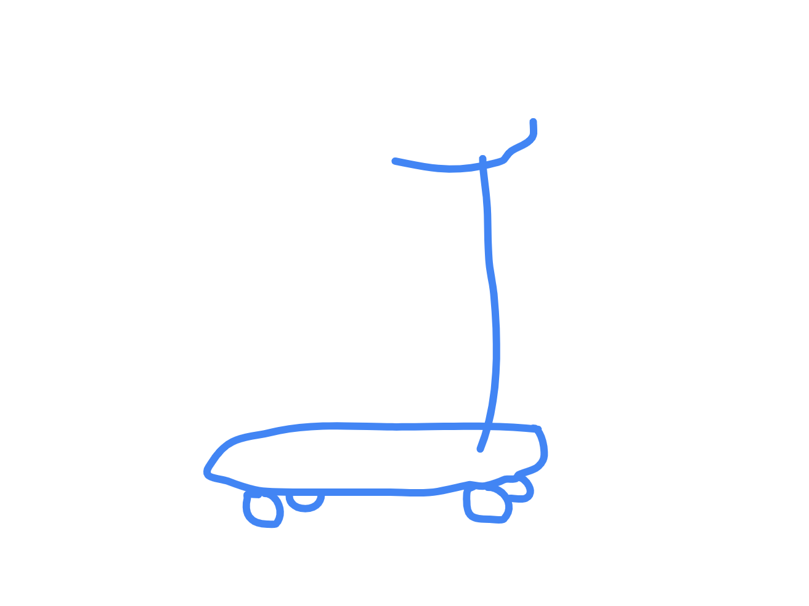
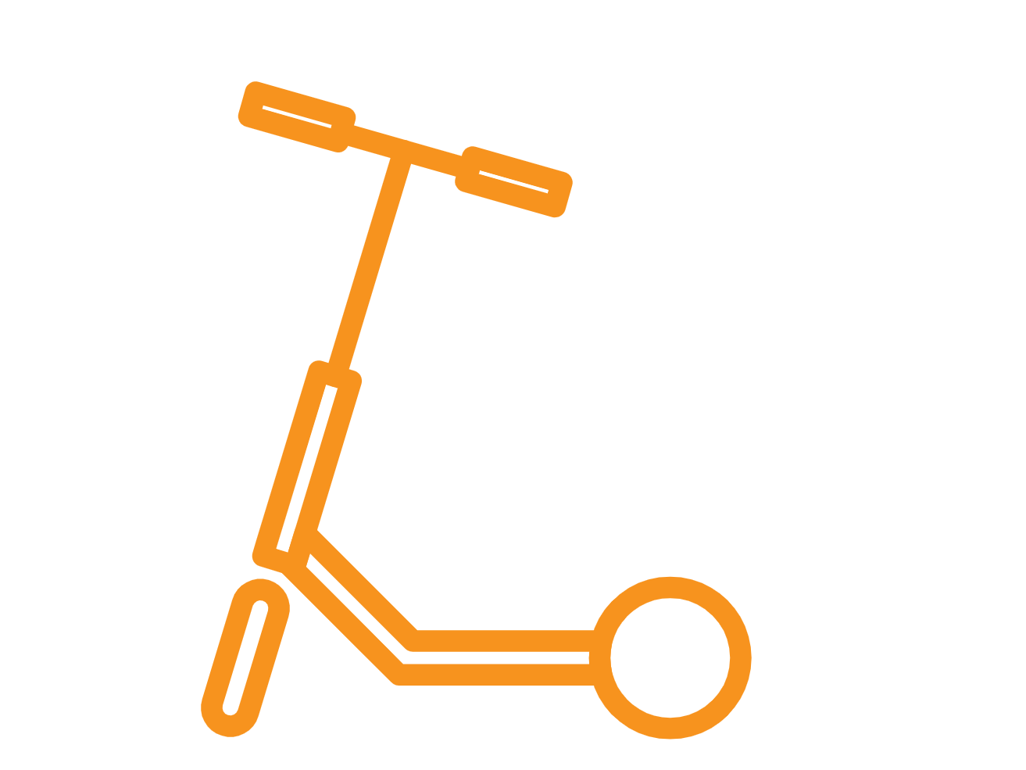
Autodraw

Slide 29
Image types
Thematic
Real life
Abstract
Illustrating concepts
Humorous
Evocative

Slide 30
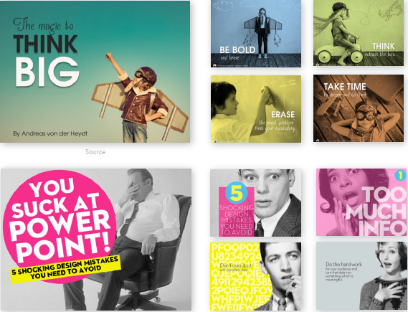
Image type: Thematic images
Notes:
Images from “A non-designer’s guide to visually captivating presentations” https://visme.co/blog/presentation-design/

Slide 31
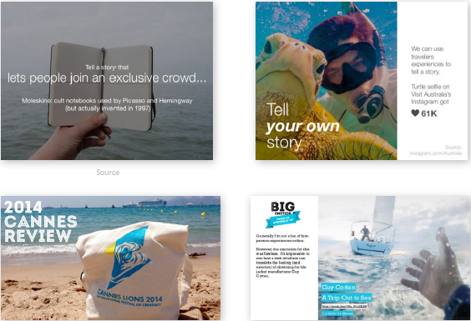
Image type: Real life
Notes:
Images from “A non-designer’s guide to visually captivating presentations” https://visme.co/blog/presentation-design/

Slide 32
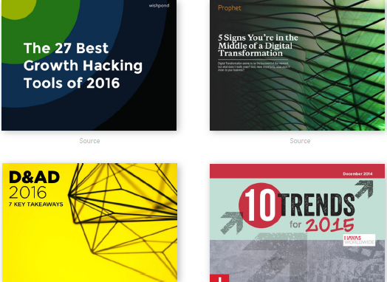
Image type: Abstract images
Notes:
Images from “A non-designer’s guide to visually captivating presentations” https://visme.co/blog/presentation-design/

Slide 33
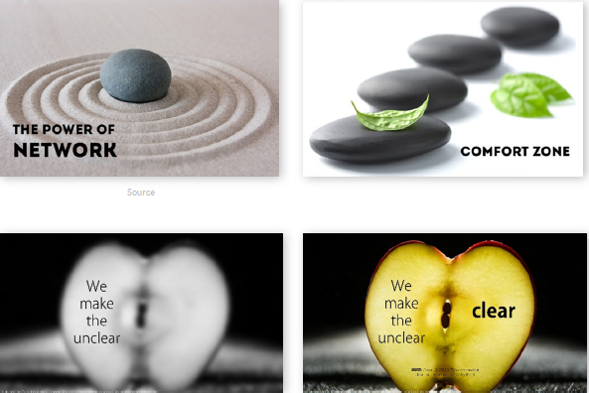
Image type: Illustrating concepts
Notes:
Images from “A non-designer’s guide to visually captivating presentations” https://visme.co/blog/presentation-design/

Slide 34
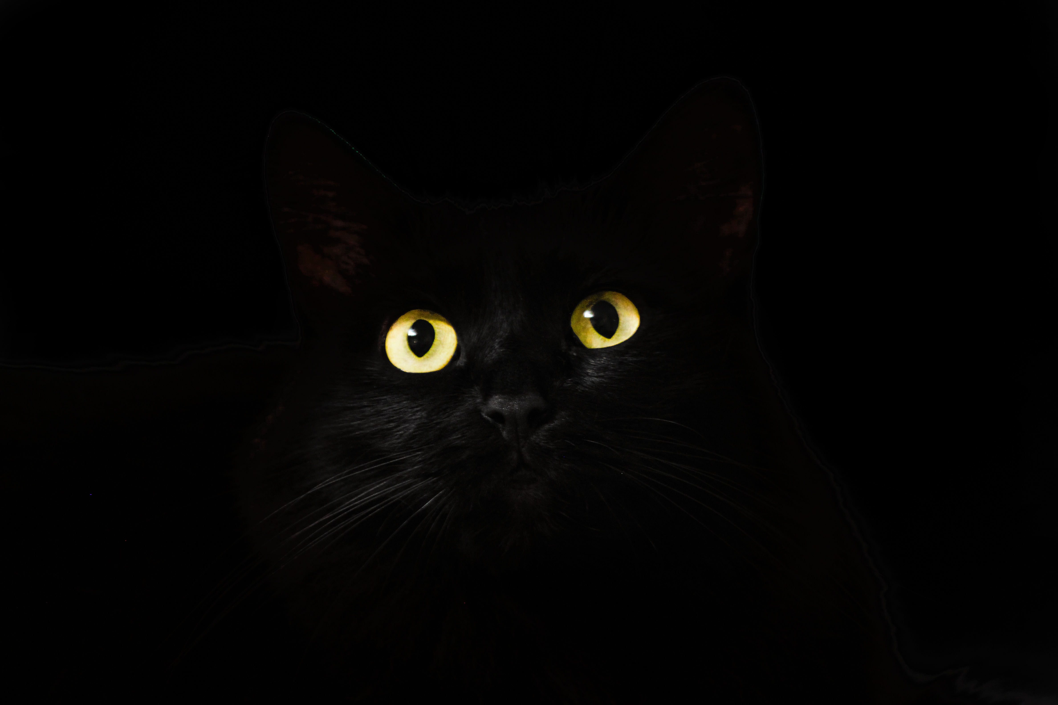
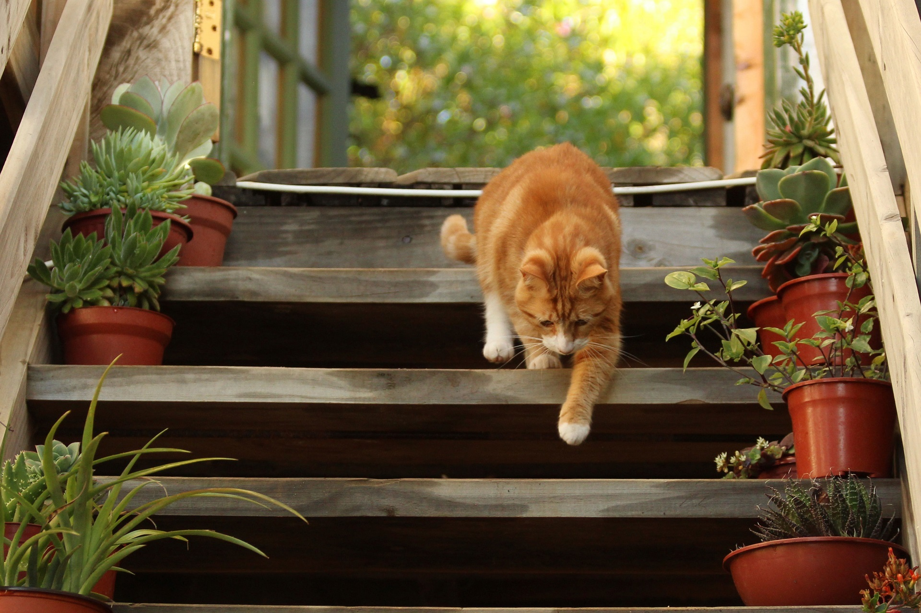

Image type: Humorous

Slide 35
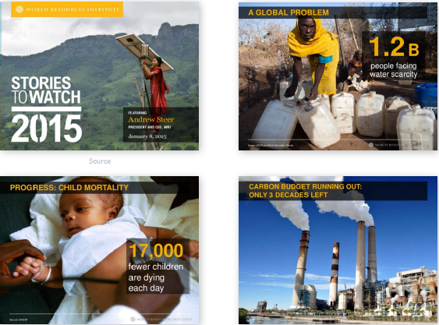
Image type: Evocative
Notes:
Images from “A non-designer’s guide to visually captivating presentations” https://visme.co/blog/presentation-design/

Slide 36
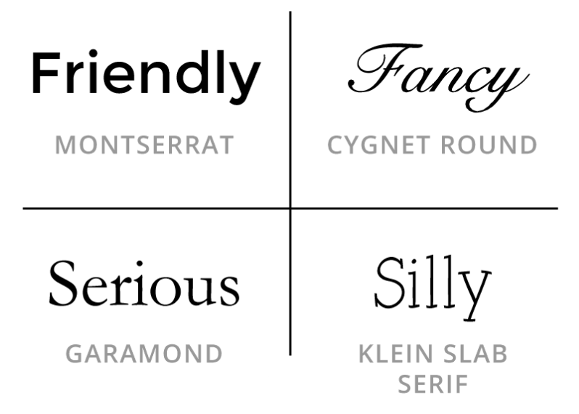
Typography: Personality and mood
Notes:
Image from https://www.canva.com/

Slide 37
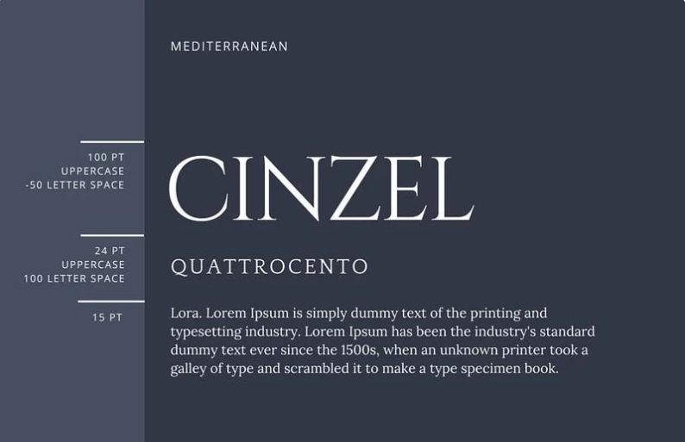
Typography: Font pairing
Notes:
Two to maximum three
Contrast and roles. Same font different styles

Slide 38
Typography: font size
A
72
A
48
A
28
A
18

Slide 39
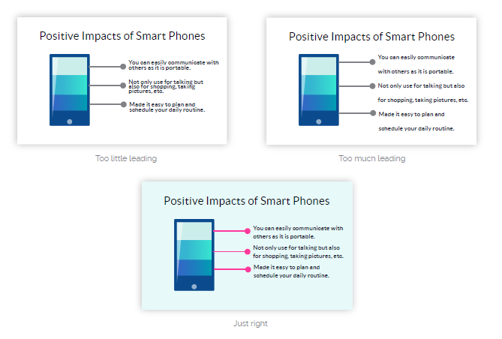
Typography: Leading

Slide 40
Delivery
Attitude, techniques

Slide 41
Delivery: attitude
Self-confidence
Inner-calm
Poise

Slide 42



Delivery: techniques
Visual contact
Voice
Body language

Slide 43
Delivery: voice
Intonation
Volume
Speed
Pauses

Slide 44
Preparation work
Process, audience, structure

Slide 45
Preparation process
Know our audience
Sort the contents
Key moments design
Draft slides
Open the computer

Slide 46
Draft slides
Prepare on paper
Brainstorm
Storyboard

Slide 47

Prepare on paper

Slide 48

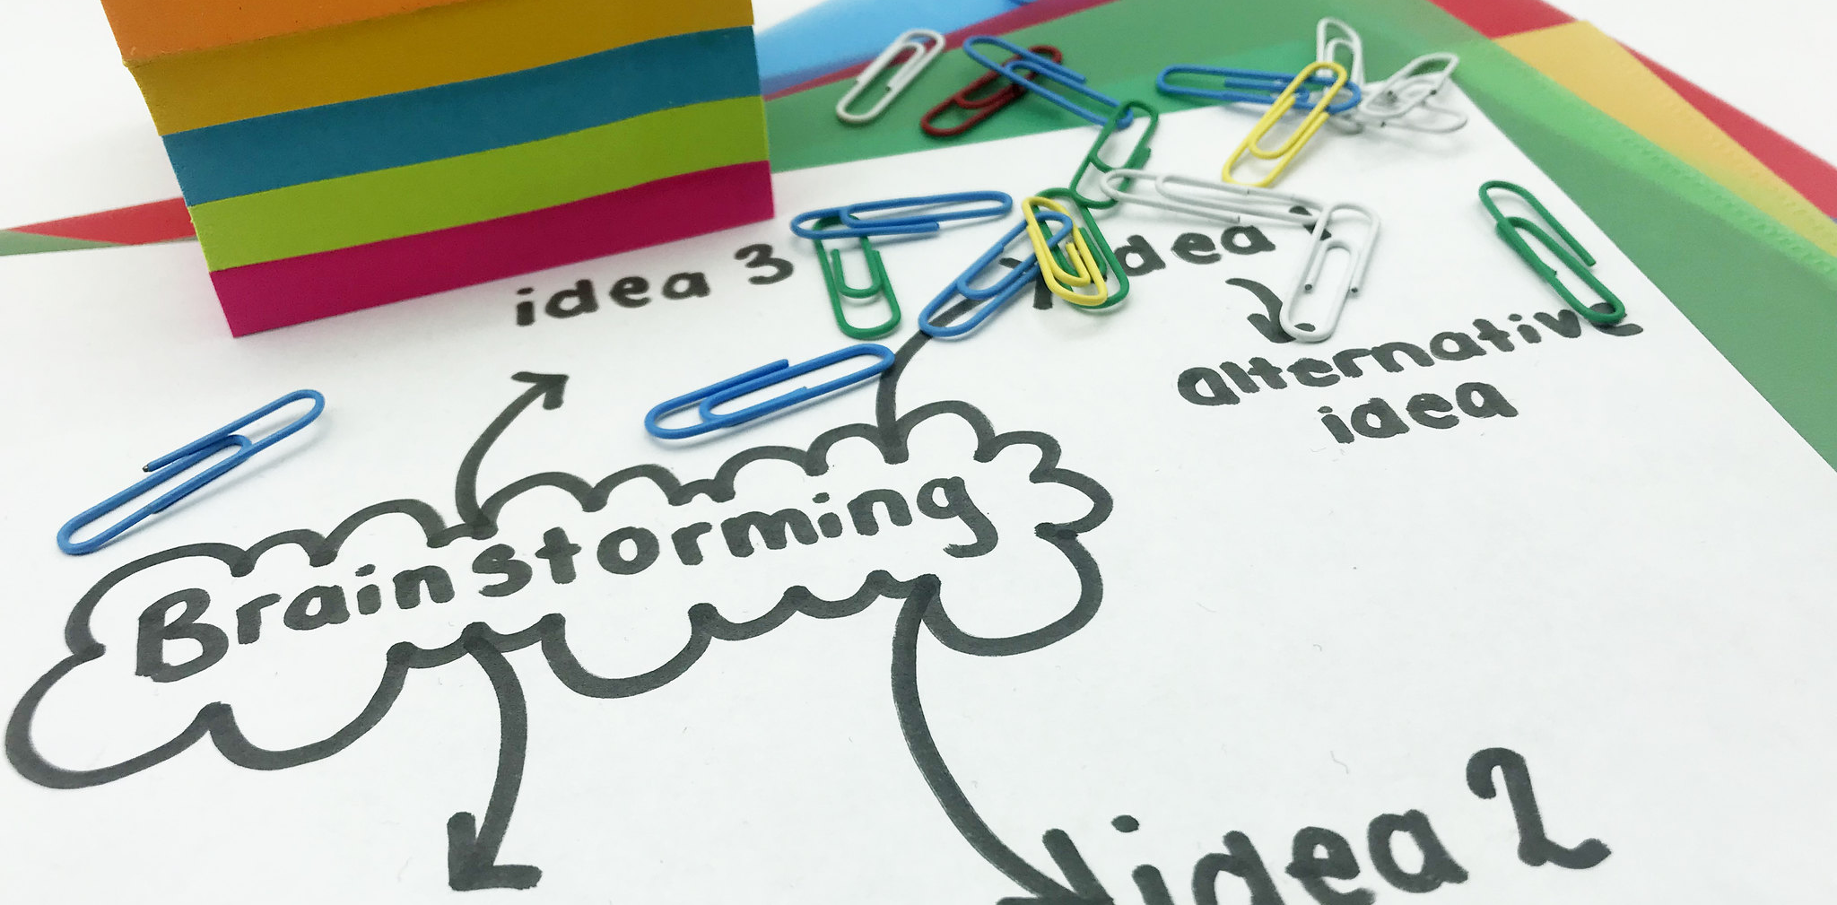
Brainstorm

Slide 49
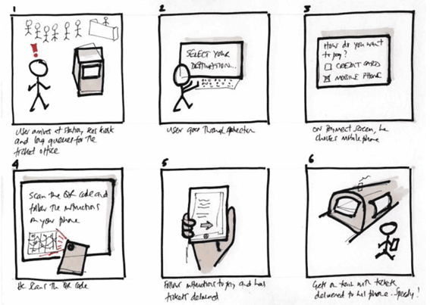
Storyboard

Slide 50
BE OBSESSED WITH THE DETAILS

Slide 51
Simplify
Reduce
Organize
Inspire

Slide 52
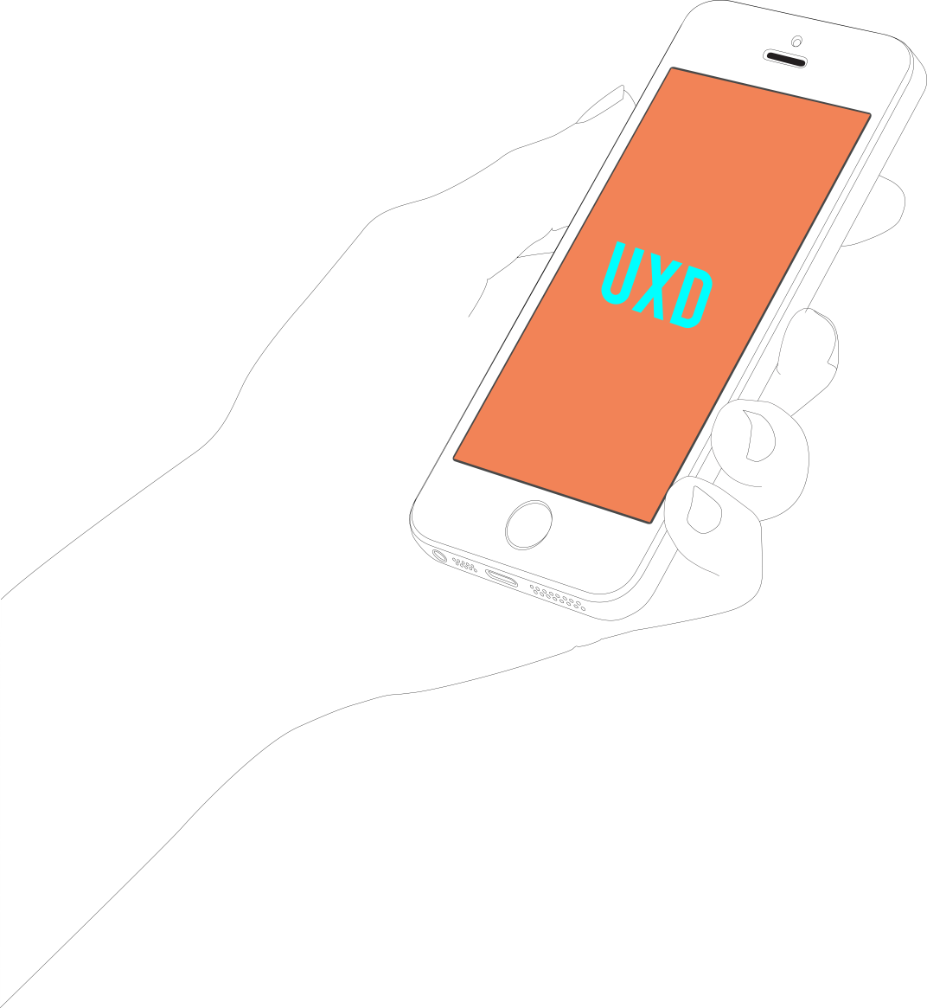
Your audience is more exigent than you may think

Slide 53
Planning
Audience
You
Slides
Who are they?
Goals
Goals
Content for goals
WOW
How are they?
Key ideas
Key ideas
Content for key ideas
GIFT
Why are they there?
Expectations
Expectations
Content for expectations
Wrap-Up

Slide 54
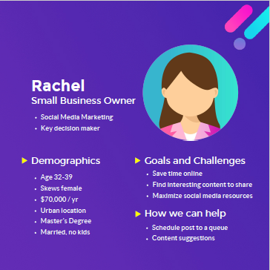
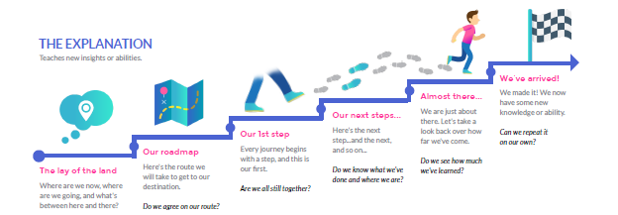
HCI techniques for complex presentations
Haga clic para agregar texto
Audience journey map
Audience personas

Slide 55
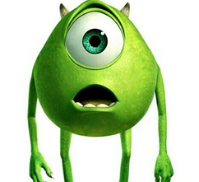
WOW
Notes:
Image taken from EIT Health preparation workshop

Slide 56

GIFT
Notes:
Image taken from EIT Health preparation workshop

Slide 57
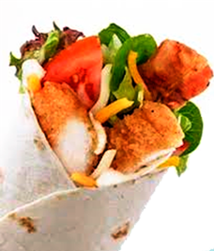
WRAP-UP
Notes:
Image taken from EIT Health preparation workshop

Slide 58

Audience attention flow
attention
WOW !
GIFT!
time
COVER
TOC
CONTENT
W-UP
Notes:
Image taken from EIT Health preparation workshop

Slide 59

What have we paid attention to?
Message
Visual design
Delivery
Notes:
Icons made by Freepik from www.flaticon.com [https://www.flaticon.com/authors/freepik]

Slide 60
RULES MAY BE BROKEN BUT NEVER IGNORED

